Slide 1
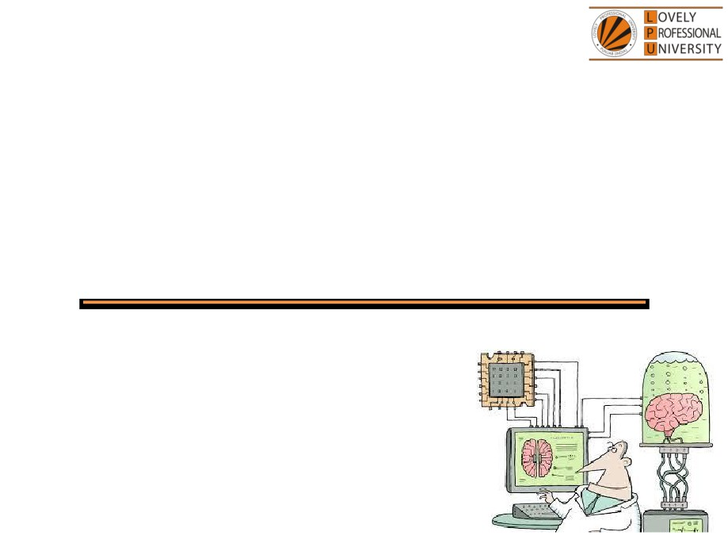
PEA516
Analytical Skills II
Lecture #0
Breaking the ice
Department of Analytical Skills

Slide 2

Course Details
LTP - 2 2 0 [Two lectures, Two Tutorial per week]
Text Book
Quantitative Aptitude by Dr.R S Aggarwal
Reference Book
ANALYTICAL REASONING by M.K. PANDEY
MAGICAL BOOK ON QUICKER MATHS by M TYRA

Slide 3
Course Assessment Model
Marks break up
• Attendance
15
• CA
30
• MTE (MCQ)
15
• ETE (MCQ)
40
• Total
100
• MTE & ETE to be done on OMR sheets
All tests will be based on MCQ.

Slide 4

Course Outcomes
CO1 :: employ the concepts learnt to analyze and solve the problems related to work based on time and efficiency.
CO2 :: select an appropriate approach to solve problems related to time, speed and distance.
CO3 :: demonstrate the various logical reasoning techniques to solve problems related to series completion, coding decoding in minimum possible time.
CO4 :: articulate an appropriate approach to solve the problems related to clock and calendar.
CO5 :: use the analytical skills to calculate the simple and compound interest.
CO6 analyze the logical reasoning aptitude problems related to puzzle test and non-verbal reasoning. to solve accordingly

Slide 5
COURSE FOCUS IDENTIFICATION
Employability

Slide 6
Assessment and Evaluation Model
Assessment (Category) | Conducted Week
CA 1 (A0203) | Week 5 (Duration 45 Min Q 30)
MTE (11A) | After week 7 (Duration 60 Minutes Q 40)
CA 2 (A0203) | Week 10 (Duration 45 Min Q 30)
CA 3 (A0203) | Week 14 (Duration 45 Min Q 30)
ETE (11A) | After week 14 (Duration 120 Min Q 80)

Slide 7
Pedagogical Initiative
Lecture Number - Week – 5,12,13
Gross- A workshop on summation of cubes
Semantic Analogy – A competitive event based on reasoning.
Math Mania-A workshop based on Permutation and combination.
(These workshops will enhance the problem-solving ability of the students as well as increase their calculation skills. Students also get familiarize with the advanced levelled questions of the topic thus increasing their competitive ability.)
Pedagogical Initiative

Slide 8
Pedagogical Initiative
Lecture Number - Week -6,7,10
Mathemagix-A workshop on speed maths.
Apti Masters- A workshop on Number System.
Code Breakers- A workshop on Crypto Arihmetic.
(These events infuse the spirit of competition in the students. Students will enhance their competitive skills in solving the questions fast. It will increase their performance to secure the ranks in the events)

Slide 9
Innovative evaluation strategies
Evaluation | Conduct
CA 1 | External
MTE | External
CA 2 | External
CA 3 | External
ETE | External

Slide 10
The course contents
Unit I
Time and Work : chain rule, computation of work done together, men, women, children based problems, wages based work problems, alternate day work
Pipes and Cisterns : inlet-outlet, part of tank filled, time based problems, alternate work
Unit II
Time and Distance : concept of time speed and distance, conversion of Units, average speed concept, different types of problems
Problem on trains : relative speed concept, faster and slower train
Boats and streams and races : downstream and upstream, linear and circular track
Unit III
Sequence and series completion : series completion, analogy, classification, arithmetic and geometric progression
Alphabet test and logical sequence of words : alphabetical order of words, letter-word problems, rule detection, alphabetical quibble

Slide 11
The course contents
Unit IV
Simple interest : basics of principal, rate and time, rate computation, time computation, amount computation
Compound interest : concept of simple and compound interest, questions based on relation between compound and simple interest
Unit V
Calendar : calculating odd days, basic concept of calendar, finding the exact day
Clocks : concept of clock angle computation, facts
Insert the missing character : set of figures, set of arrangements, set of matrix
Unit VI
Coding inqualities : basic operations, rules of inequalities, coded relations
Puzzle test : seating/placing arrangements, comparison type questions, sequential order of things

Slide 12


Let us look around…
Why every organization takes Quantitative Aptitude Tests before hiring any future employee…

Slide 13
Right Decision Making
Mental Alertness
Ability to quickly interpret data
Establish logical relationship
Arrive at the correct conclusions
Make the right judgment

Slide 14
Edu-Revolution: Be the Change Initiatives
EDU-Revolution Categories
Revenue Generation
Social Media Presence
Project
Recognition of Prior Learning
NPTEL/MOOC
Grade Upgradation (Core/Non-Core)
Internship Beyond the Curriculum
Community Service
Co-curricular/Extra curricular activities
10% Attendance Benefit
Duty Leave
Earn Extra Credit

Slide 15
Edu-Revolution: Be the Change Initiatives
EDU-REVOLUTION:
bringing in a transformative shift in education
Students will be offered a variety of learning options
the initiatives will be designed to provide flexibility in key academic areas
This initiative will address the following key aspects:
[A] Course Equivalence and Attendance Relaxation
[B] Grade Revision and Overall Welfare (GROW)
[C] 10 % Attendance waiver for students in Pre-final/Final year of the programme
[D] Continuous Assessment Reduction Through Experience (CARE)
[E] Students in active decision-making through Student Committees
PEA-221 Analytical Skills :: Department of Analytical Skills

Slide 16
[A] Course Equivalence and Attendance Relaxation:
The students will be provided an opportunity to seek attendance relaxation and course equivalence for some courses registered to him/her in the upcoming term through various platforms as detailed below.
Recognition of Prior Learning (RPL):
Students who believe they already possess the required knowledge or skills in a course, can request relaxation from the course and attendance via an online interface. This will be applicable for basic elementary courses such as English, Mathematics, Analytical skills, Soft skills etc.
2. NPTEL Course/MOOCs/Certifications:
A student can request for course and attendance relaxation in upcoming term’s course in lieu of any NPTEL Course/MOOCs/Certifications he/she wishes to pursue in that term.
3. Pursuing Project: Students wishing to pursue project against any course of upcoming term may receive course equivalence and attendance relaxation
PEA-221 Analytical Skills :: Department of Analytical Skills

Slide 17
[B] Grade Revision and Overall Welfare (GROW):
The students will now be extended an opportunity to improve their existing grade(s) through various other learning options as:
Competitions/Hackathons
2. Entrepreneurial Venture
3. Publications/Patents/Copyrights
4. Performance in higher studies, Recruitment Exam (GATE/ JAM, UGC-NET, CAT, AFCAT, CDS, IELTS, CTET etc.)
5. Projects/consultancy taken in collaboration with NGO/agency for social service
6. Social Media Presence (Blogs/Vlogs created and posted on various social media platforms)
PEA-221 Analytical Skills :: Department of Analytical Skills

Slide 18
[C] 10 % Attendance waiver for students in Pre-final/Final year of the programme:
Students with a CGPA of 8 or higher can apply for an attendance relaxation in their pre-final/final year. Eligible students will be granted a 10% attendance relaxation to support their career development.
[D] Continuous Assessment Reduction through Experience (CARE):
Students who are wishing to explore innovative learning methods or alternative approaches may apply for CA modifications by opting for real-life problem-solving assignments, social service, blogs, vlogs on social media etc .
PEA-221 Analytical Skills :: Department of Analytical Skills

Slide 19
E] Students in active decision-making through Student Committees
Students will be actively involved in decision-making related to academic and learning procedures applicable to them, by becoming a member of various committees as listed below:
a. Student Academic and Project Review Committee
b. Student Career Committee
c. Student entrepreneurship and Media Committee
The students can submit their nominations through UMS for becoming members of their desired committee.
UMS link to apply for all the above-mentioned initiatives:
UMS Navigation --- LMS EDU Revolution: BE THE CHANGE
PEA-221 Analytical Skills :: Department of Analytical Skills

Slide 20
Organizations recruit people who have
Quick Mental Abilities.
PEA502 Analytical Skills-II :: Vishal Ahuja

Slide 21
How you will make your mental ability Quick…!!!
Quick = Tricks
PEA502 Analytical Skills-II :: Vishal Ahuja

Slide 22
A monkey jumps 5 yards every second on a 60 yards vertical pole and then falls down 2 yards over the next second. How many seconds will it take to climb the pole?

Slide 23

1 minute…???
2 minutes…???
5 minutes…???
10 minutes…???
Well…!!! It will not take more than 30 SECONDS

Slide 24
And What about this….?
On which day of the week INDIAN constitution formed?
26 Jan 1950!!

Slide 25
5 minute…???
10 minutes…???
15 minutes…???
20 minutes…???
Again…!!! It will not take more than 30 SECONDS.

Slide 26

What is the angle between the hands at 3:15 in an analog clock
What do we need to know?

Slide 27
What do we need to know?
This course PEA516 : Analytical Skills-II
Ability to efficiently solve the company specific Quantitative
Aptitude Tests.
Ability to prioritize and manage Time.
Ability to efficiently analyze data.

Slide 28


Next Class: Time and Work

